Slide 1
Introduction: AIMD
ML-Excited States

Slide 2
Machine Learning Potential Models
arXiv:2202.02541 [cs.LG], https://doi.org/10.48550/arXiv.2202.02541
ML-Excited States

Slide 3
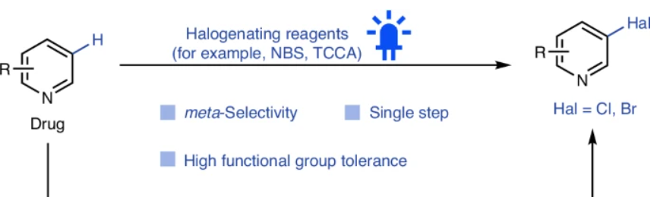
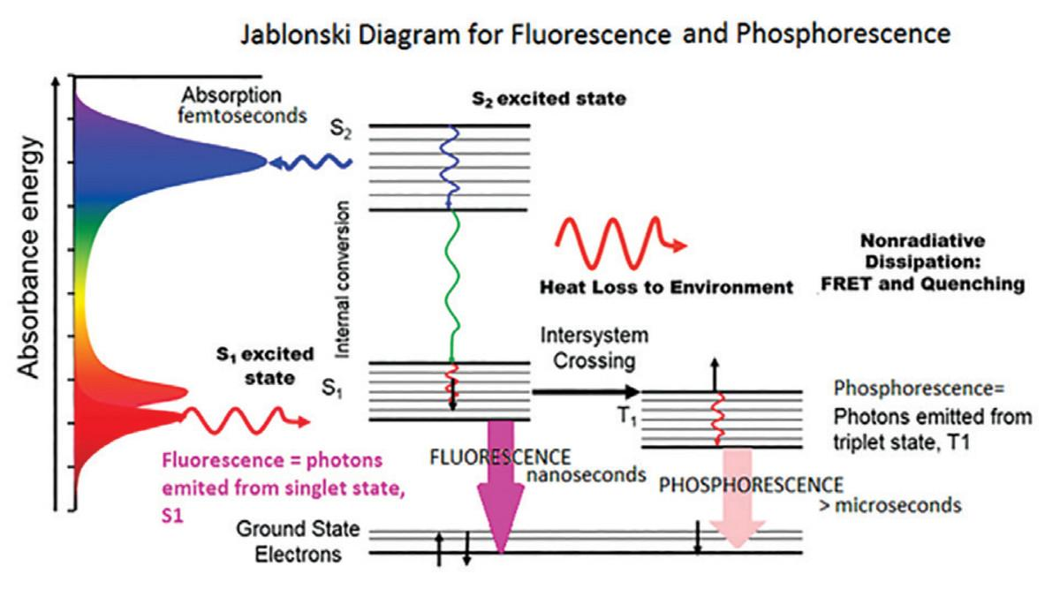
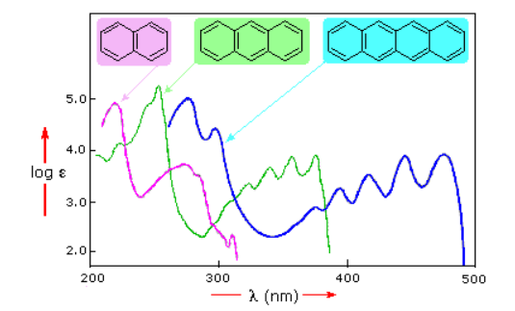
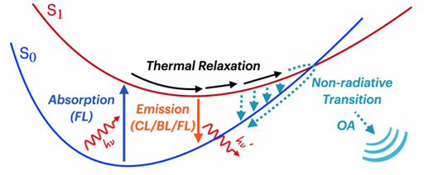
Excited States
Photochemistry
Spectrum
Bio probes
molecule absorbs photon(s) to be excited, and is described by excited states.
ML-Excited States

Slide 4
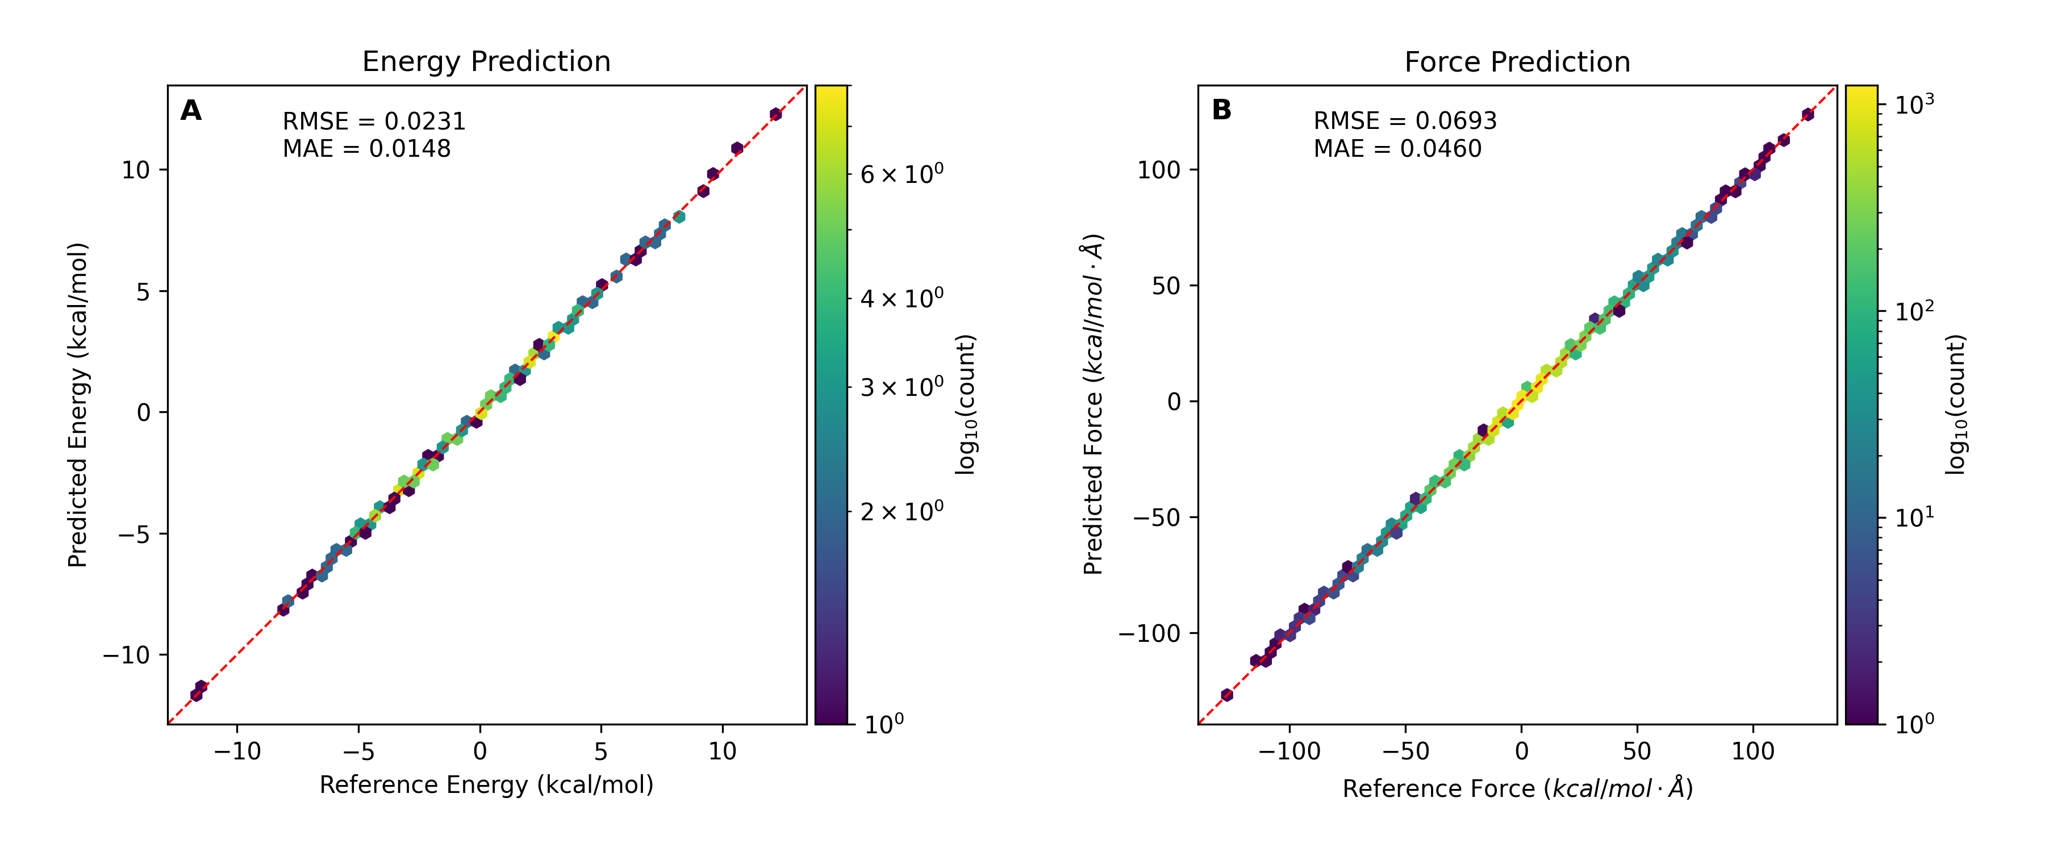
Machine Learning Potential Models
Figure 1. TorchmdNet model results for energy and forces of PhBDI⁻, ground states. Trained on 1000 frames with 200 validation frames. Tested on 400 frames.
There’re various machine learning potential(MLP) models,
Most of them do achieve chemical accuracy(below 1kcal/mol MAE & RMSE) for ground states.
What about excited states?
PhBDI⁻
Charge:-1
27 atoms
arXiv:2202.02541 [cs.LG], https://doi.org/10.48550/arXiv.2202.02541
ML-Excited States

Slide 5

Configuration Interaction Singles (CIS)
Ground State: Hartree-Fock DFT
Excited States: CIS TDDFT
Configuration Interaction Singles(CIS) excited 1 electron each time from ground states to get single-excited configuration
ML-Excited States

Slide 6
Sample molecule
Bodipy
Charge:0
31 atoms
PhBDI
Charge:-1
27 atoms
Rhodamine
Charge:1
37 atoms
Squaraine
Charge:0
84 atoms
AIMD ~10000 frames
Sample
~3000
frames
TDDFT
calculation
Train/Test
ML-Excited States

Slide 7
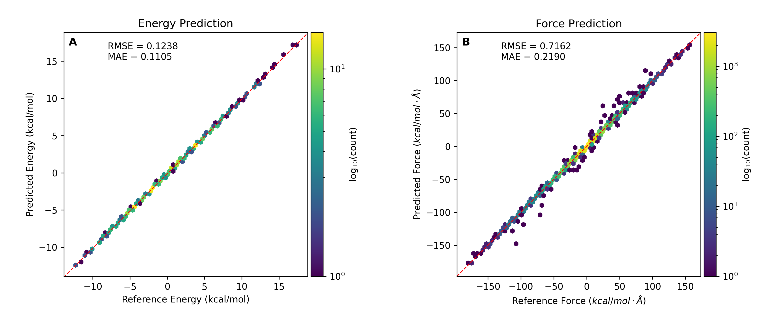
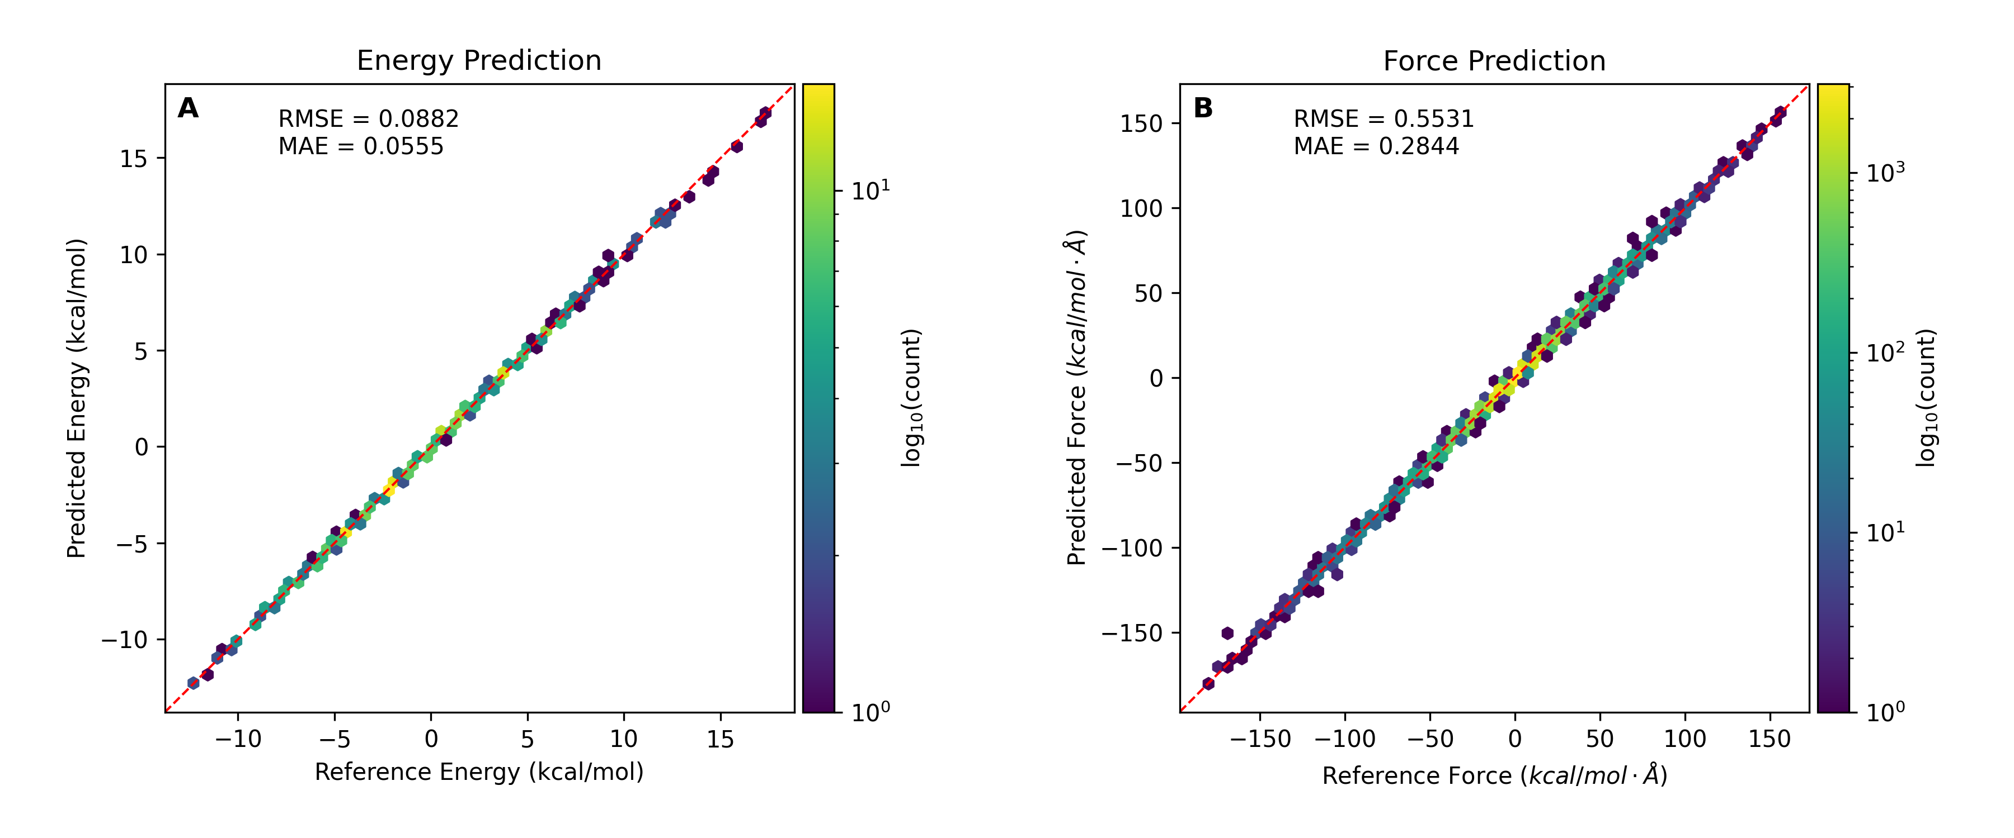
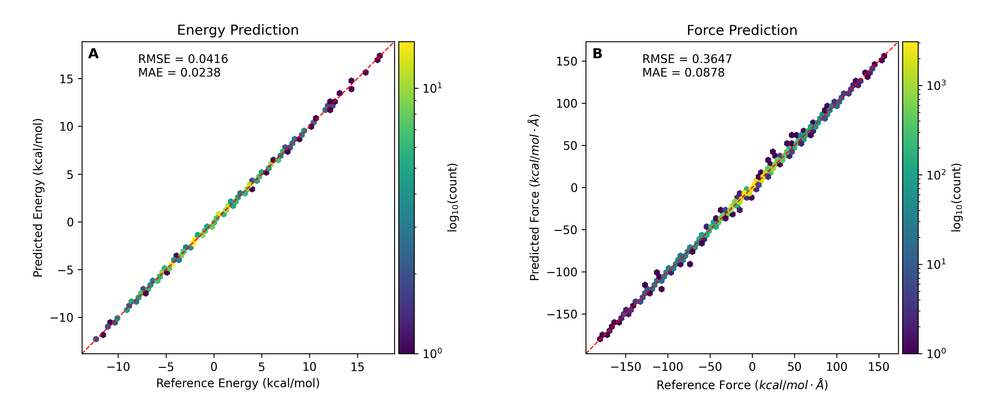
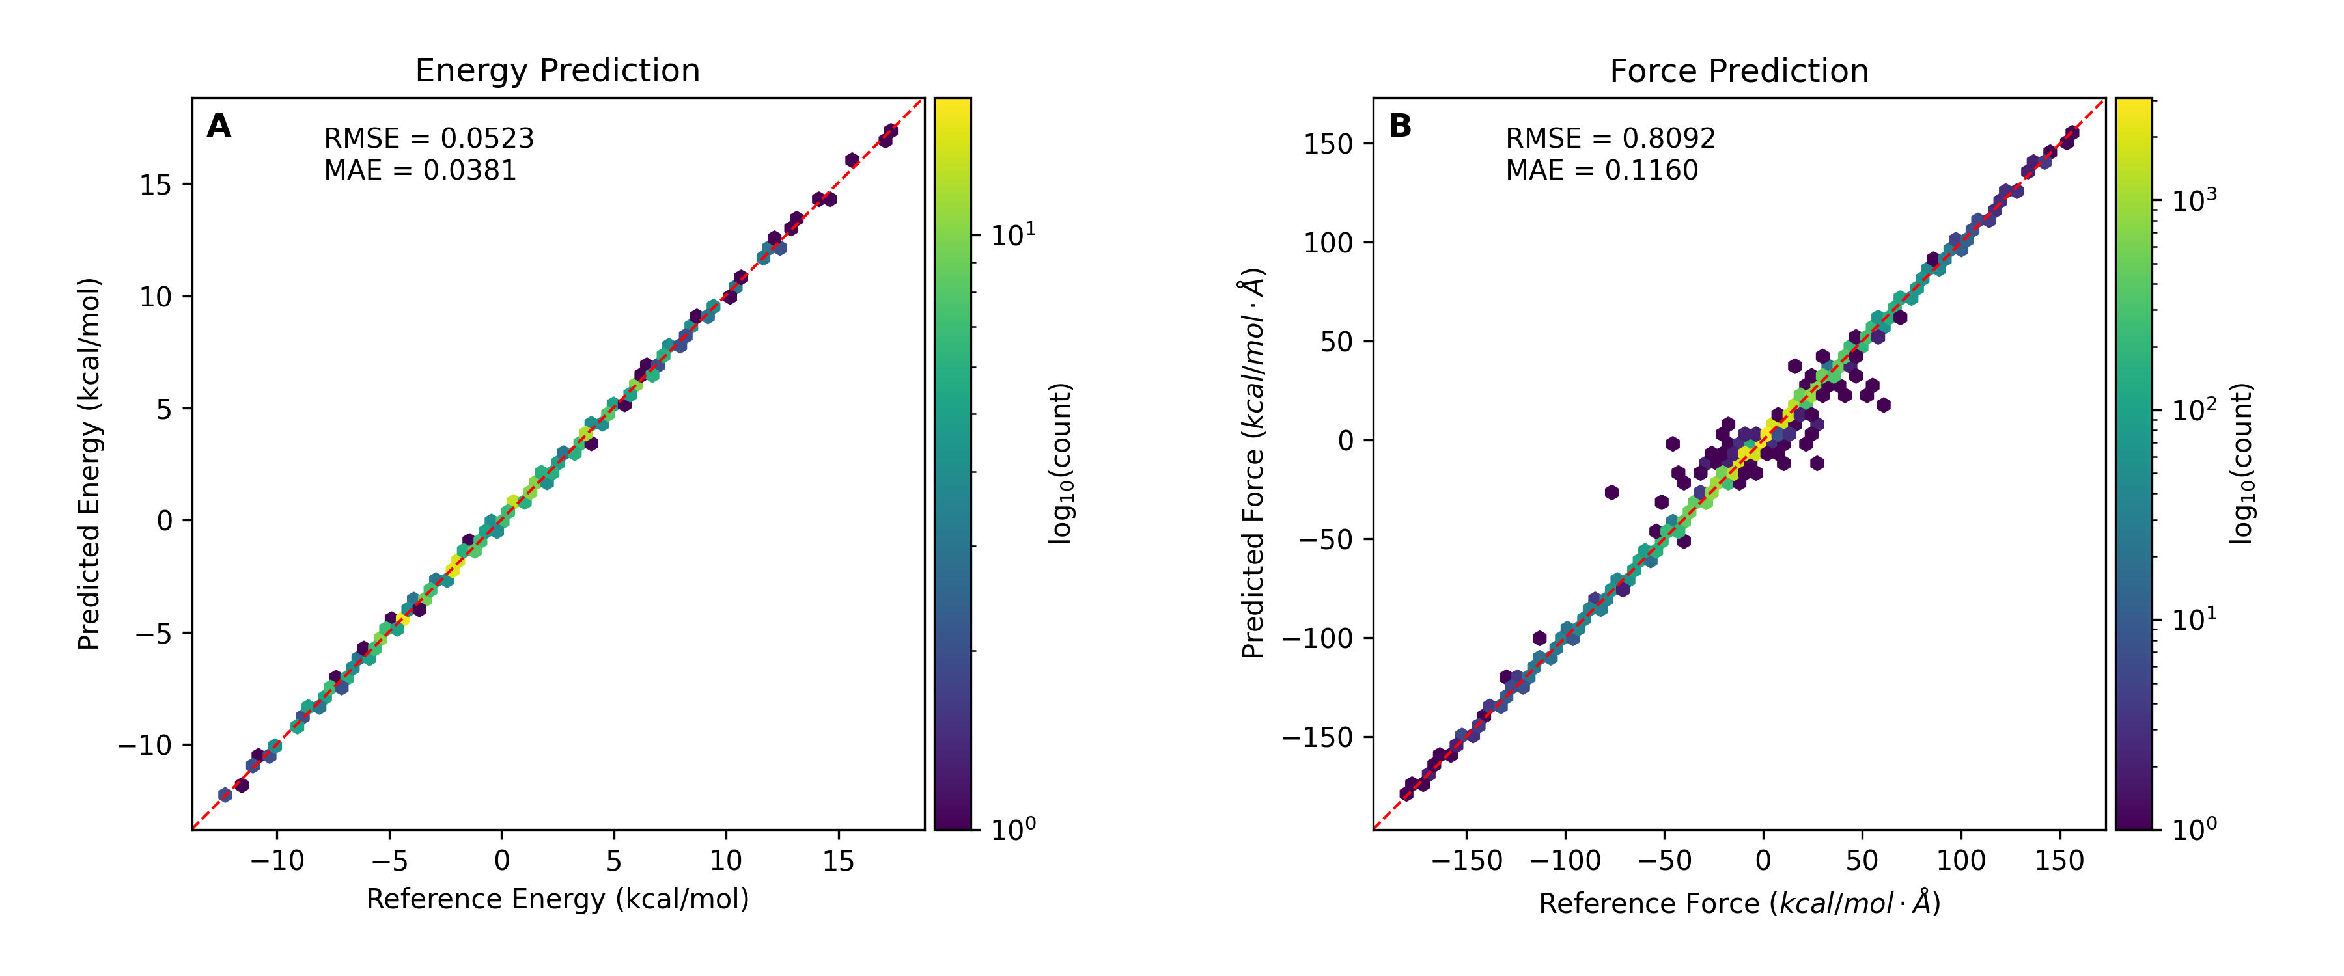
PhBDI⁻ Dataset Size Benchmark
(250 frames)
(2000 frames)
TensorNet model for PhBDI⁻, trained on 250/500/1000/2000 frames with 50/100/200/400 validation frames, and tested on same 400 frames in total. MAE=0.11/0.06/0.02/0.04, RMSE=0.12/0.09/0.04/0.05 kcal/mol for energy and MAE=0.22/0.28/0.09/0.12, RMSE=0.72/0.55/0.36/0.81 kcal/mol·Å for force.
ML-Excited States

Slide 8
PhBDI⁻ Dataset Size Benchmark
TensorNet model for PhBDI⁻, trained on 500 frames with 100 validation frames, and tested on 400 frames in total.
ML-Excited States

